Slide 1

MANGAYARKARASI COLLEGE OF ENGINEERING
FAKE NEWS DETECTION USING NLP
Submitted by:
K.Porkalaiselvi
G.Sakthi Priya
G.Sathya
S.I.Syed Ali Fathima
3rd year ECE
Guided by:
Mrs.B.K.Hemalatha
A Survey on Natural Language Processing for Fake News Detection
Fake news detection is a critical yet challenging problem in Natural Language Processing (NLP). The rapid rise of social networking platforms has not only yielded a vast increase in information accessibility but has also accelerated the spread of fake news. Thus, the effect of fake news has been growing, sometimes extending to the offline world and threatening public safety. Given the massive amount of Web content, automatic fake news detection is a practical NLP problem useful to all online content providers, in order to reduce the human time and effort to detect and prevent the spread of fake news. In this paper, we describe the challenges involved in fake news detection and also describe related tasks. We systematically review and compare the task formulations, datasets and NLP solutions that have been developed for this task, and also discuss the potentials and limitations of them. Based on our insights, we outline promising research directions, including more fine-grained, detailed, fair, and practical detection models. We also highlight the difference between fake news detection and other related tasks, and the importance of NLP solutions for fake news detection.

Slide 2

Text Pre-processing Using NLP
Table: The analysis of the occurrence of email addresses, social media addresses, website addresses (https and www) in the ISOT dataset
Type of address | ISOT dataset (True) | ISOT dataset (Fake)
email and social media addresses | 803 | 27888
https addresses | 0 | 94
www addresses | 48 | 726

Slide 3
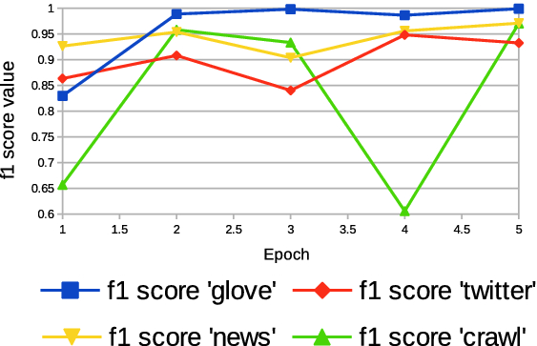
Resulted metrics for testing of models for the label fake (the comparison between word embeddings techniques, ‘glove’, ‘news’, ‘twitter’, ‘crawl’)
As a result of the training, models with calculated parameters, i.e., weights were obtained. These models were tested on the remote Colaboratory platform. The first stage of testing consisted of entering selected texts contained in the ISOT dataset. In the second stage of testing, the Independent, which is a British online newspaper, and the 11 Sci-Fi Short Stories website were used. Articles in the Independent were treated as a source of credible texts (true), and science fiction stories as a source of unreliable materials (false). For both the above-described tests, the model worked correctly and detected true and false information. Tests were carried out repeatedly, confirming the validity, robustness and credibility of the model. Examples of correct model operation are shown in fig. All entered texts were subjected to the procedure of eliminating irrelevant elements from texts, before submitting them to the model. The procedure is identical to the one carried out in the pre-processing stage on the raw data.

Slide 4
BERT CLASSIFICATION MODEL
BERT, or Bidirectional Encoder Representations from Transformers, is a cutting-edge natural language processing (NLP) model developed by Google. What sets BERT apart is its ability to understand the context of words in a sentence by considering both the words that come before and after them, allowing it to grasp nuances, context, and meaning in language more effectively. BERT has achieved remarkable success in various NLP tasks, including text classification, sentiment analysis, and machine translation, and it has become a cornerstone in the field of AI for understanding and generating human language.
Before proceeding with the loading of the pre-trained BERT model, a crucial step lies ahead: tokenization of our data. At present, our input data points remain in their textual format, necessitating their transformation into tokens. This transformation is essential to enable the subsequent processing of our data by the BERT model.
For this, we are using CNN and LSTM as the base algorithms. Apart from the base algorithms used, we are having used the Ensembling technique via the soft voting method which is a model having its accuracy, thus increasing the overall probability of truth for the given dataset.

Slide 5
Datasets:
The datasets we used in this study are open source and freely available online. The data includes both fake and truthful news articles from multiple domains. The truthful news articles published contain true description of real world events, while the fake news websites contain claims that are not aligned with facts. The conformity of claims from the politics domain for many of those articles can be manually checked with fact checking websites such as politifact.com and snopes.com. We have used three different datasets in this study, a brief description of which is provided as follows.
The first dataset is called the “ISOT Fake News Dataset” [23] (hereafter referred to as DS1) which contains both true and fake articles extracted from the World Wide Web. The true articles are extracted from reuters.com which is a renowned news website, while the fake articles were extracted from multiple sources, mostly websites which are flagged by politifact.com. The dataset contains a total of 44,898 articles, out of which 21,417 are truthful articles and 23,481 fake articles. The total corpora contain articles from different domains, but most prominently target political news.
The second dataset is available at Kaggle [24] (hereafter referred to as DS2) which contains a total of 20,386 articles used for training and 5,126 articles used for testing. The dataset is built from multiple sources on the Internet. The articles are not limited to a single domain such as politics as they include both fake and true articles from various other domains.
The third dataset is also available at Kaggle [25] (hereafter referred to as DS3); it includes a total of 3,352 articles, both fake and true. The true articles are extracted from trusted online sources such as CNN, Reuters, the New York Times, and various others, while the fake news articles are extracted from untrusted news websites. The domains it covered include sports, entertainment, and politics.

Slide 6
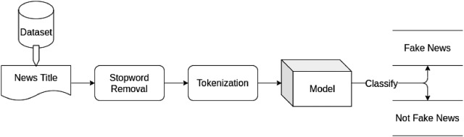
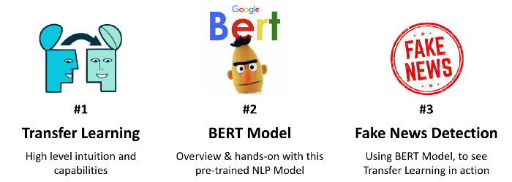
BERT model
BERT, or Bidirectional Encoder Representations from Transformers, is a cutting-edge natural language processing (NLP) model developed by Google. What sets BERT apart is its ability to understand the context of words in a sentence by considering both the words that come before and after them, allowing it to grasp nuances, context, and meaning in language more effectively.

Slide 7
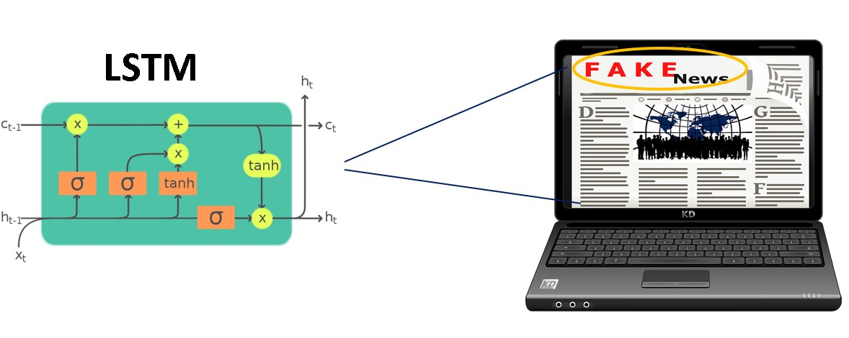
LSTM model
The LSTM model showed an accuracy of 0.8667 on the testing set. The LSTM model outperformed the Multinomial Naive Bayes and K-Nearest Neighbors Classifier models in terms of testing accuracy. The results suggest that the LSTM model has potential for use in fake news detection.
In this tutorial, we are going to develop a Fake News Classifier using Long Short Term
Memory (LSTM).

